Slide 1
بسم الله الرحمن الرحیم
Notes:
Introduce yourself
ان شاء الله که وخت خوب و پربرکت خواهیم داشت

Slide 2
CS101 Introduction to Computer Science

Slide 3
Lecture 4

Slide 4
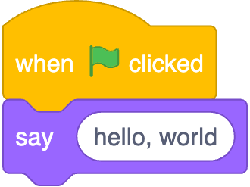
Notes:
https://scratchblocks.github.io/#?style=scratch3&script=when%20green%20flag%20clicked%0Asay%20%5Bhello%2C%20world%5D

Slide 5
#include <stdio.h>
int main(void) {
printf("hello, world\n");
}

Slide 6
#include <stdio.h>
int main(void) {
printf("hello, world\n");
}

Slide 7
source code

Slide 8
01111111 01000101 01001100 01000110 00000010 00000001 00000001 00000000 00000000 00000000 00000000 00000000 00000000 00000000 00000000 00000000 00000010 00000000 00111110 00000000 00000001 00000000 00000000 00000000 10110000 00000101 01000000 00000000 00000000 00000000 00000000 00000000 01000000 00000000 00000000 00000000 00000000 00000000 00000000 00000000 11010000 00010011 00000000 00000000 00000000 00000000 00000000 00000000 00000000 00000000 00000000 00000000 01000000 00000000 00111000 00000000 00001001 00000000 01000000 00000000 00100100 00000000 00100001 00000000 00000110 00000000 00000000 00000000 00000101 00000000 00000000 00000000 01000000 00000000 00000000 00000000 00000000 00000000 00000000 00000000 01000000 00000000 01000000 00000000 00000000 00000000 00000000 00000000 01000000 00000000 01000000 00000000 00000000 00000000 00000000 00000000 11111000 00000001 00000000 00000000 00000000 00000000 00000000 00000000 11111000 00000001 00000000 00000000 00000000 00000000 00000000 00000000 00001000 00000000 00000000 00000000 00000000 00000000 00000000 00000000 00000011 00000000 00000000 00000000 00000100 00000000 00000000 00000000 00111000 00000010 00000000 00000000 00000000 00000000 00000000 00000000 ...

Slide 9
machine code

Slide 10
input →
→ output
Notes:
starting today, no green flag

Slide 12
source code →

Slide 13
source code →
→ machine code

Slide 14
compiler
source code →
→ machine code

Slide 15
Visual Studio Code
Notes:
where to write, compile code

Slide 16
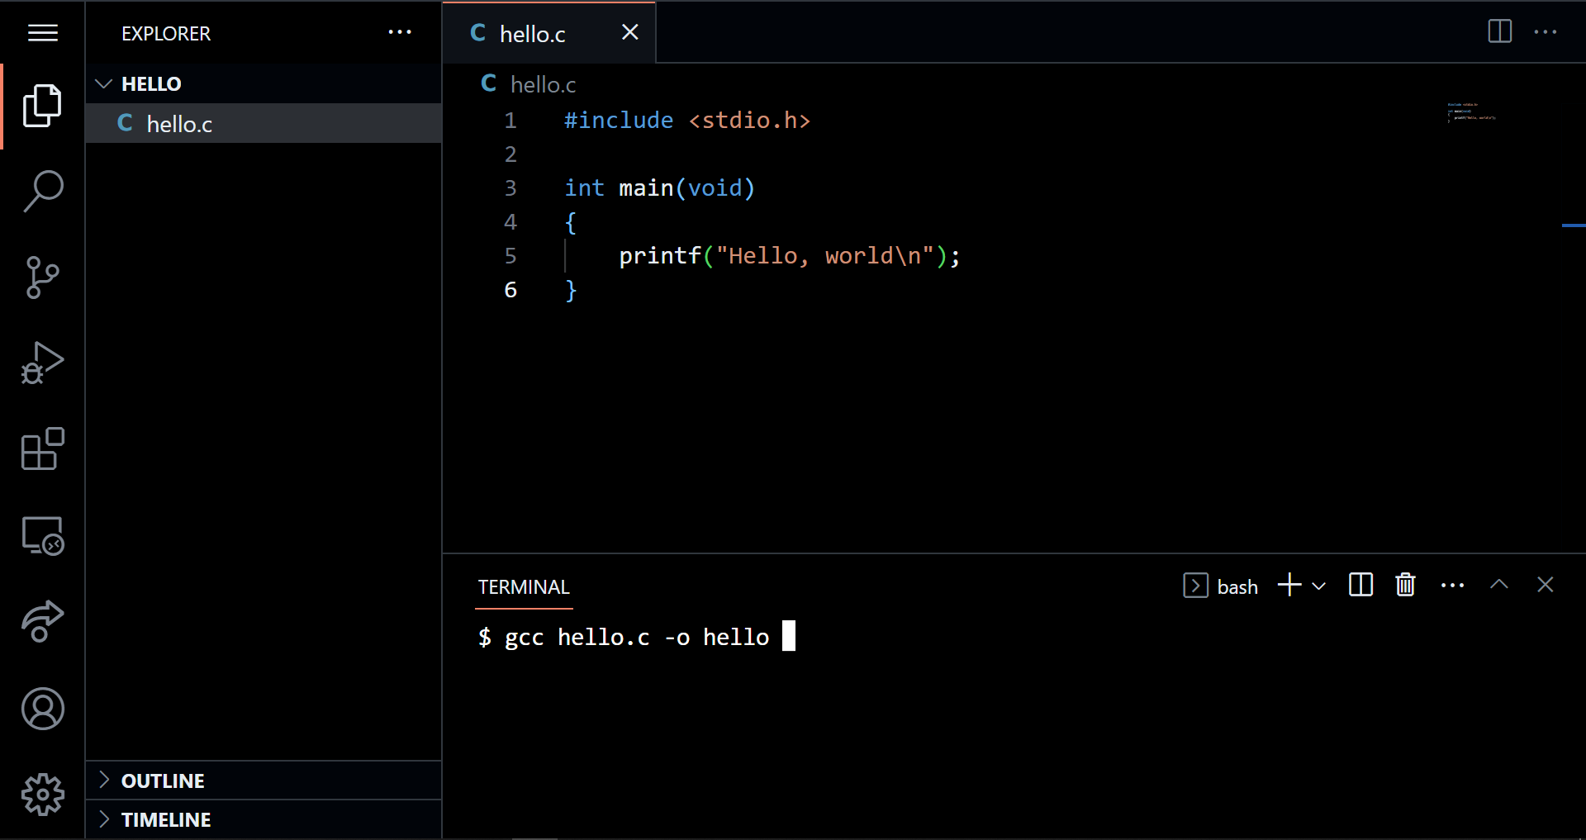

Slide 22
graphical user interface

Slide 23
GUI

Slide 24
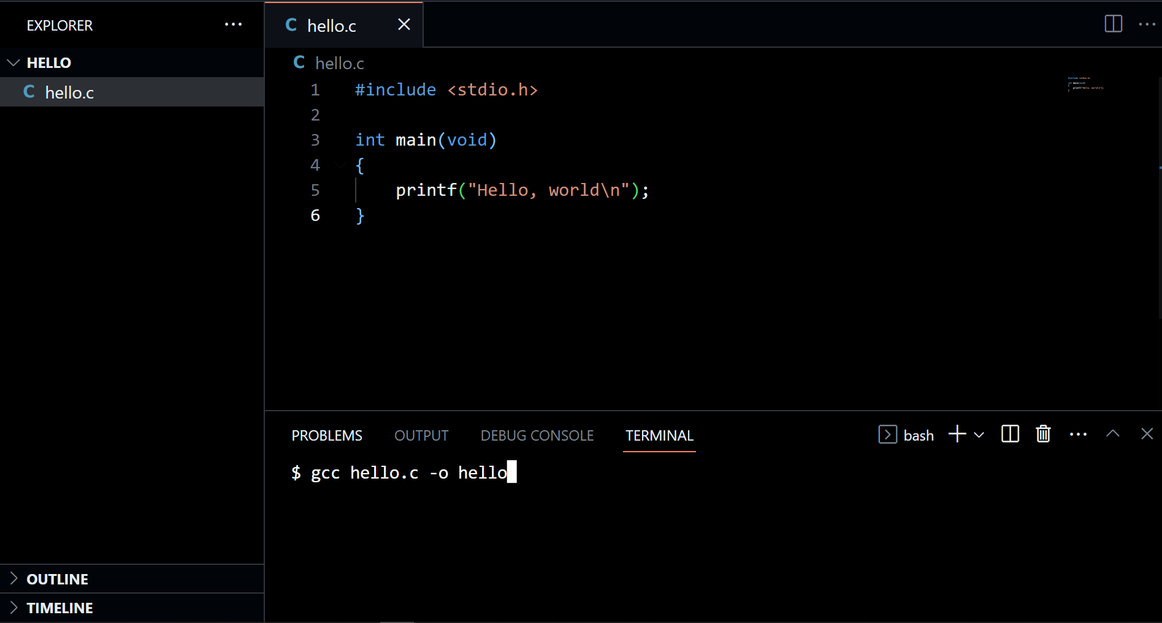

Slide 25
command-line interface

Slide 26
CLI

Slide 27
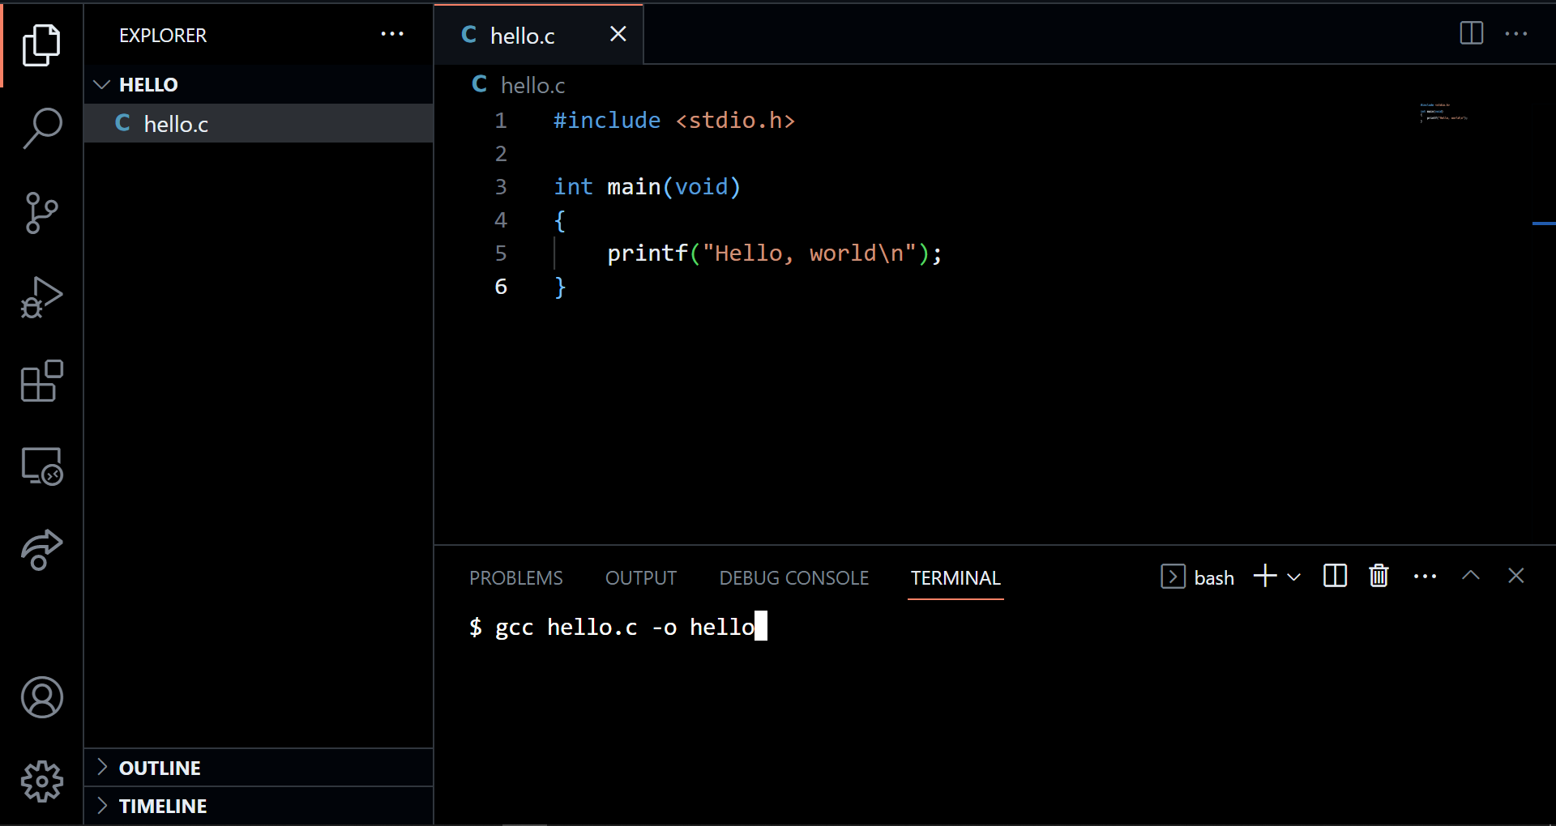

Slide 28
#include <stdio.h>
int main(void) {
printf("hello, world\n");
}
Notes:
hello0.c

Slide 29
code hello.c
gcc hello.c -o hello
./hello

Slide 30
Notes:
https://scratchblocks.github.io/#?style=scratch3&script=when%20green%20flag%20clicked%0Asay%20%5Bhello%2C%20world%5D

Slide 31
#include <stdio.h>
int main(void) {
printf("hello, world\n");
}

Slide 32
#include <stdio.h>
int main(void) {
printf("hello, world\n");
}

Slide 33

printf("hello, world\n");

Slide 34
printf("hello, world\n");

Slide 35
printf("hello, world\n");

Slide 36
printf("hello, world\n");

Slide 37
printf("hello, world\n");

Slide 38
printf("hello, world\n");

Slide 39
printf("hello, world\n");
Notes:
lot of ways to make mistakes; try omitting semicolon

Slide 40

Notes:
https://editor.codecogs.com/

Slide 41
input →
→ output

Slide 42
function
arguments →
→ side effects

Slide 43
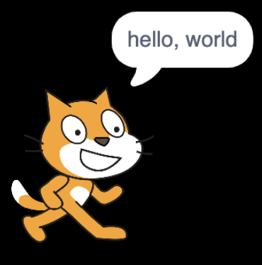


→
→
Notes:
https://scratchblocks.github.io/#?style=scratch3&script=say%20%5B%5D
https://scratchblocks.github.io/#?style=scratch3&script=say%20%5Bhello%2C%20world%5D

Slide 44
escape sequences
Notes:
try omitting \n

Slide 45
\n
\t
\r
\"
\'
\\
…
Notes:
For double quote give an example of “Ahmad said: “Hi!””

Slide 46
header files
Notes:
try removing stdio.h

Slide 47
libraries

Slide 48
stdio.h

Slide 49
Manual Pages
manual.cs50.io

Slide 50
manual.cs50.io/#stdio.h

Slide 51
manual.cs50.io/3/printf

Slide 52
cs50.h

Slide 53
manual.cs50.io/#cs50.h

Slide 54
get_char
get_double
get_float
get_int
get_long
get_string
...

Slide 55
get_char
get_double
get_float
get_int
get_long
get_string
...

Slide 56
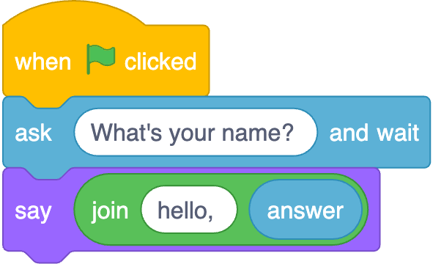
Notes:
https://scratchblocks.github.io/#?style=scratch3&script=when%20green%20flag%20clicked%0Aask%20%5BWhat's%20your%20name%3F%20%5D%20and%20wait%0Asay(join%20%5Bhello%2C%20%5D%20(answer))

Slide 57
input →
→ output
Notes:
starting today, no green flag

Slide 58
function
arguments →
→ return value

Slide 59
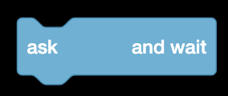


→
→
Notes:
https://scratchblocks.github.io/#?style=scratch3&script=ask%20%5B%5D%20and%20wait
https://scratchblocks.github.io/#?style=scratch3&script=ask%20%5BWhat's%20your%20name%3F%5D%20and%20wait
https://scratchblocks.github.io/#?style=scratch3&script=(answer)

Slide 60
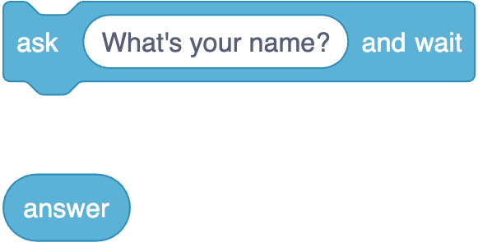
Notes:
https://scratchblocks.github.io/#?style=scratch3&script=ask%20%5BWhat's%20your%20name%3F%5D%20and%20wait%0A(answer)

Slide 61
string answer = get_string( );
printf("hello, %s", answer);

Slide 62
string answer = get_string("What's your name? ");
printf("hello, %s", answer);

Slide 63
string answer = get_string("What's your name? ");
printf("hello, %s", answer);

Slide 64
string answer = get_string("What's your name? ");
printf("hello, %s", answer);

Slide 65
string answer = get_string("What's your name? ");
printf("hello, %s", answer);

Slide 66
string answer = get_string("What's your name? ");
printf("hello, %s", answer);
Notes:
hello1.c

Slide 67
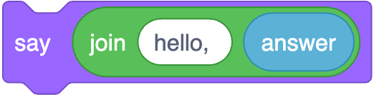
printf("hello, %s", answer);
Notes:
https://scratchblocks.github.io/#?style=scratch3&script=say%20(join%5Bhello%2C%20%5D%20(answer)%0A

Slide 68
printf("hello, %s\n", answer);

Slide 69
printf("hello, %s\n", answer);

Slide 70
printf("hello, %s\n", answer);

Slide 71
printf("hello, %s\n", answer);

Slide 72
printf("hello, %s\n", answer);
Notes:
hello2.c

Slide 73
cd
cp
ls
mkdir
mv
rm
rmdir
...

Slide 74
cd
cp
ls
mkdir
mv
rm
rmdir
...
Notes:
rm hello
mkdir hello/
mv hello.c hello
cd hello
mv hello.c old.c
mv old.c hello.c
cp hello.c backup.c
rm backup.c
mv hello.c ..
cd
rmdir hello

Slide 75
types

Slide 76
bool
char
double
float
int
long
string
...

Slide 77
bool
char
double
float
int
long
string
...

Slide 78
bool
char
double
float
int
long
string
...

Slide 79
get_char
get_double
get_float
get_int
get_long
get_string
...

Slide 80
get_char
get_double
get_float
get_int
get_long
get_string
...

Slide 81
format codes

Slide 82
%c
%f
%i
%li
%s

Slide 83
%c
%f
%i
%li
%s

Slide 84
%c
%f
%i
%li
%s

Slide 85
conditionals

Slide 86
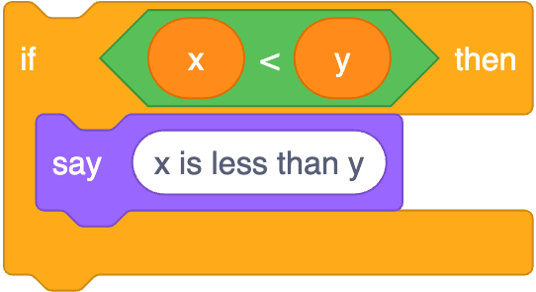
if (x < y) {
printf("x is less than y\n");
}
Notes:
https://scratchblocks.github.io/#?style=scratch3&script=if%20%3C(x)%20%3C%20(y)%3E%20then%0Asay%20%5Bx%20is%20less%20than%20y%5D

Slide 87
if (x < y) {
printf("x is less than y\n");
}

Slide 88
if (x < y) {
printf("x is less than y\n");
}

Slide 89
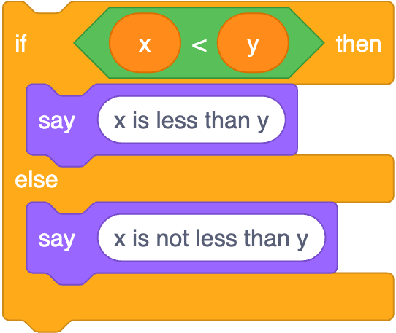
if (x < y) {
printf("x is less than y\n");
}
else
{ printf("x is not less than y\n");
}
Notes:
https://scratchblocks.github.io/#?style=scratch3&script=if%20%3C(x)%20%3C%20(y)%3E%20then%0Asay%20%5Bx%20is%20less%20than%20y%5D%0Aelse%0Asay%20%5Bx%20is%20not%20less%20than%20y%5D

Slide 90
if (x < y) {
printf("x is less than y\n");
}
else
{ printf("x is not less than y\n");
}

Slide 91
if (x < y) {
printf("x is less than y\n");
}
else
{ printf("x is not less than y\n");
}

Slide 92
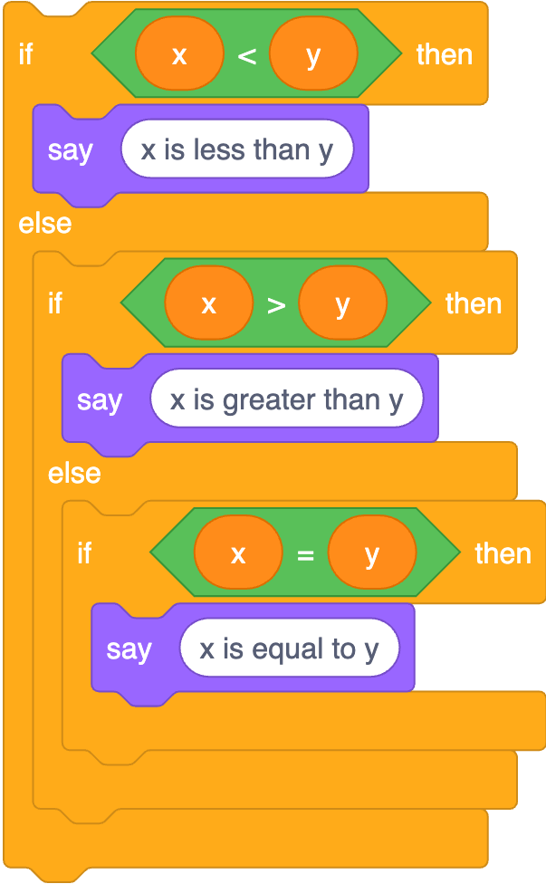
if (x < y) {
printf("x is less than y\n");
}
else if (x > y)
{ printf("x is greater than y\n");
}
else if (x == y)
{ printf("x is equal to y\n");
}
Notes:
https://scratchblocks.github.io/#?style=scratch3&script=if%20%3C(x)%20%3C%20(y)%3E%20then%0Asay%20%5Bx%20is%20less%20than%20y%5D%0Aelse%0Aif%20%3C(x)%20%3E%20(y)%3E%20then%0Asay%20%5Bx%20is%20greater%20than%20y%5D%0Aelse%0Aif%20%3C(x)%20%3D%20(y)%3E%20then%0Asay%20%5Bx%20is%20equal%20to%20y%5D

Slide 93
if (x < y) {
printf("x is less than y\n");
}
else if (x > y)
{ printf("x is greater than y\n");
}
else if (x == y)
{ printf("x is equal to y\n");
}

Slide 94
if (x < y) {
printf("x is less than y\n");
}
else if (x > y)
{ printf("x is greater than y\n");
}
else if (x == y)
{ printf("x is equal to y\n");
}

Slide 95
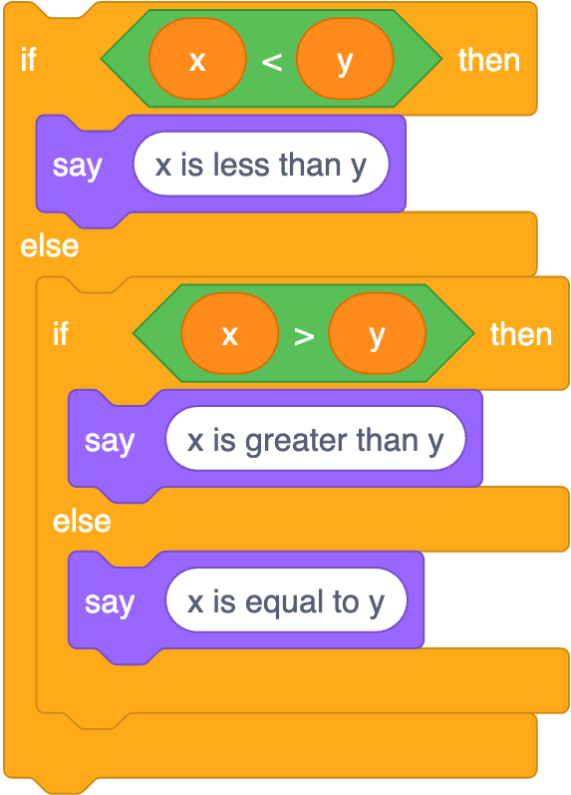
if (x < y) {
printf("x is less than y\n");
}
else if (x > y)
{ printf("x is greater than y\n");
}
else
{ printf("x is equal to y\n");
}
Notes:
https://scratchblocks.github.io/#?style=scratch3&script=if%20%3C(x)%20%3C%20(y)%3E%20then%0Asay%20%5Bx%20is%20less%20than%20y%5D%0Aelse%0Aif%20%3C(x)%20%3E%20(y)%3E%20then%0Asay%20%5Bx%20is%20greater%20than%20y%5D%0Aelse%0Asay%20%5Bx%20is%20equal%20to%20y%5D

Slide 96
operators

Slide 97
=
<
<=
>
>=
==
!=
…

Slide 98
variables

Slide 99
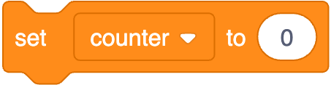
int counter = 0;
Notes:
https://scratchblocks.github.io/#?style=scratch3&script=set%20%5Bcounter%20v%5D%20to%20%5B0%5D

Slide 100
int counter = 0;

Slide 101
int counter = 0;

Slide 102
int counter = 0;

Slide 103

counter = counter + 1;
Notes:
https://scratchblocks.github.io/#?style=scratch3&script=change%20%5Bcounter%20v%5D%20by%20%5B1%5D

Slide 104
counter = counter + 1;;

Slide 105
counter += 1;

Slide 106
counter++;

Slide 107

counter--;
Notes:
https://scratchblocks.github.io/#?style=scratch3&script=change%20%5Bcounter%20v%5D%20by%20%5B-1%5D

Slide 108
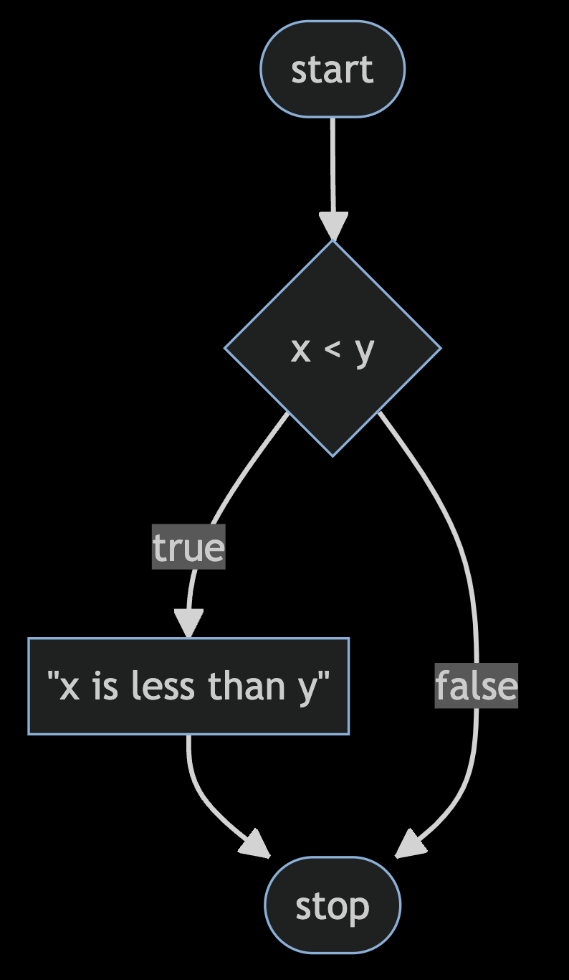
Notes:
compare0.c
https://mermaid.live/edit#pako:eNpNkMFugzAMhl_F8i5Dgheg06QBO-7UntZwsEg6UCGhidFAiHdfSMY0n-zvt39bXrExUmGOt958Ny1ZhkslNPh4e7469qBOIMteoVhneIFli2LhGbCdVNDKq8Cnx2T4NEPnoFfOAbekYYlUYB3HytBe7c5mrJN_XjfqXTT7XY8pDsoO1El_3bozgdyqQQnMfSrJ3gUKvfk-mticF91gvl-U4jRKYlV19GVpwDxYH_RddmzsH1Sh_Ig_CK9IcST9acwxuP0A4V5a9A

Slide 109
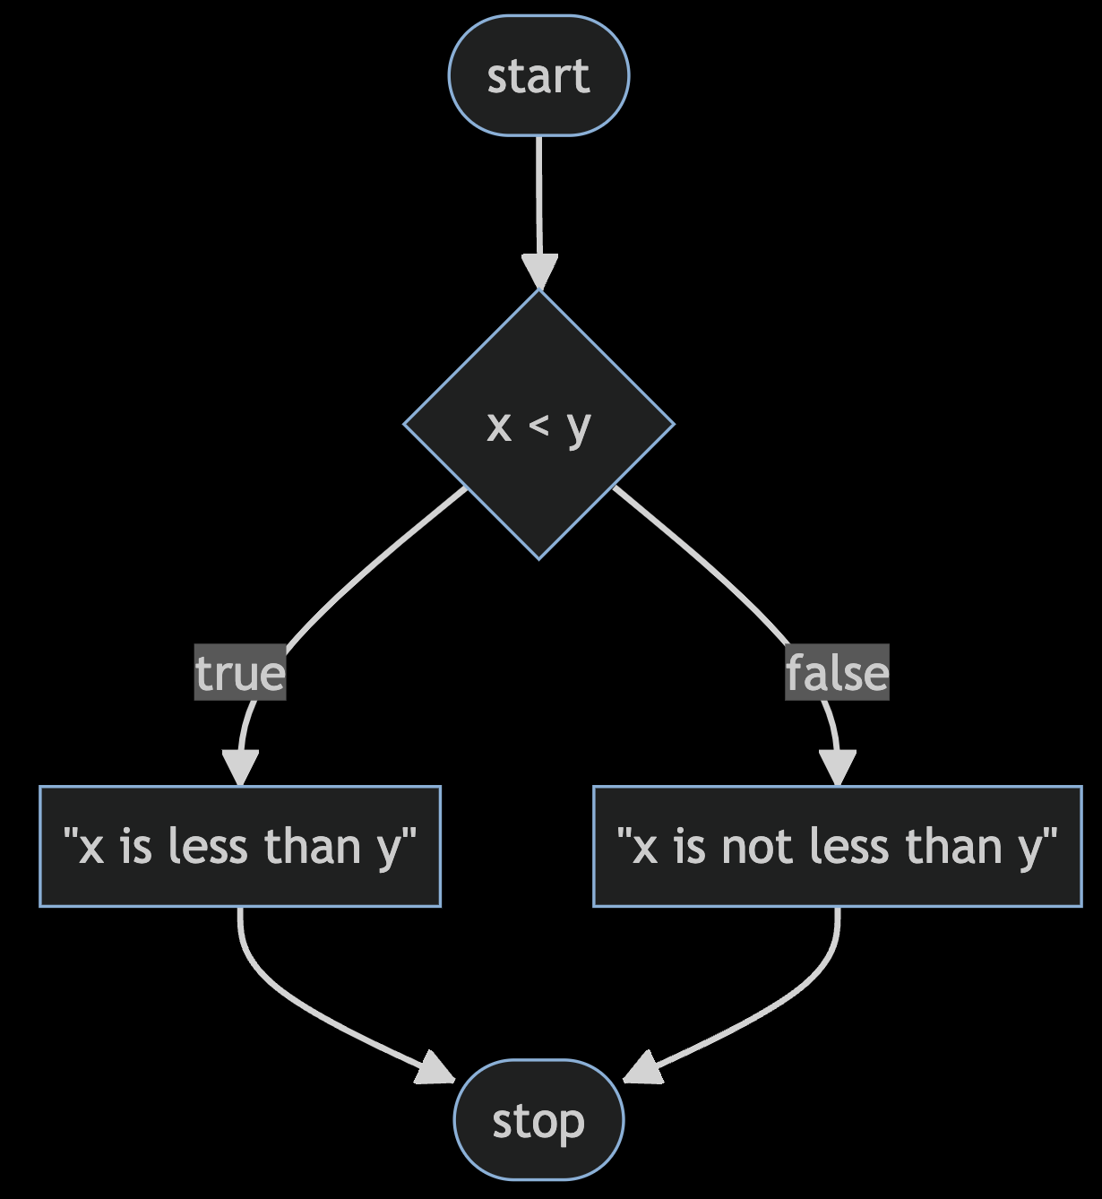
Notes:
compare1.c
https://mermaid.live/edit#pako:eNp9kMFugzAMhl_F8i6rRF-AVZXWwrGn7rSGg0XSgQoxS4xWhHj3hUSdtst8sv_f_mR7xpq1wRyvHX_VDTmBt0JZCPH6fPEShGoD2-0eDvMddjAtyTwEDcSNJnrHi8Knz5Hl5Q6th854D9KQhSmpCqs0doztxUrmodr8Yl2p8wlW_oVZln-AZQKuKWbYG9dTq8M582orlMb0RmEeUk3uplDZJfTRKHyebI35ekKG46BJTNHSh6Me87jLQy11K-x-RBPLU3pa_F2GA9l35sfg8g0ckGn4

Slide 110
Notes:
compare2.c
https://mermaid.live/edit#pako:eNptkcFugzAMhl_F8i6rRF-ArZXWBtrLTttpDQeLpAUNCE2CVoR494WgUtCWU_L792c77jBVQmKI50L9pBlpC5-MV-DO2_PJWCckK1ivt7DrbvAKbT8Gd04DqxvpY_sTx6dro-zLDXIDhTQGbEYVtKPKMRnT9t7OHGo7odgCFS1RFy3JSv0_LfIZsaNtNhMuXuAOS5y8NlSAVX9QB-8-DiOrOlnNhjxTYUYWm_X7UONZ2Yd6xABLqUvKhfvcbvBwtJksJcfQXQXpb4686p2PGqs-2irFcGg7wKYWbmaW00VTiaGH3tVI5FbpSZT--T6u0G8ywJqqL6Xuif0vYHGQ9A

Slide 111
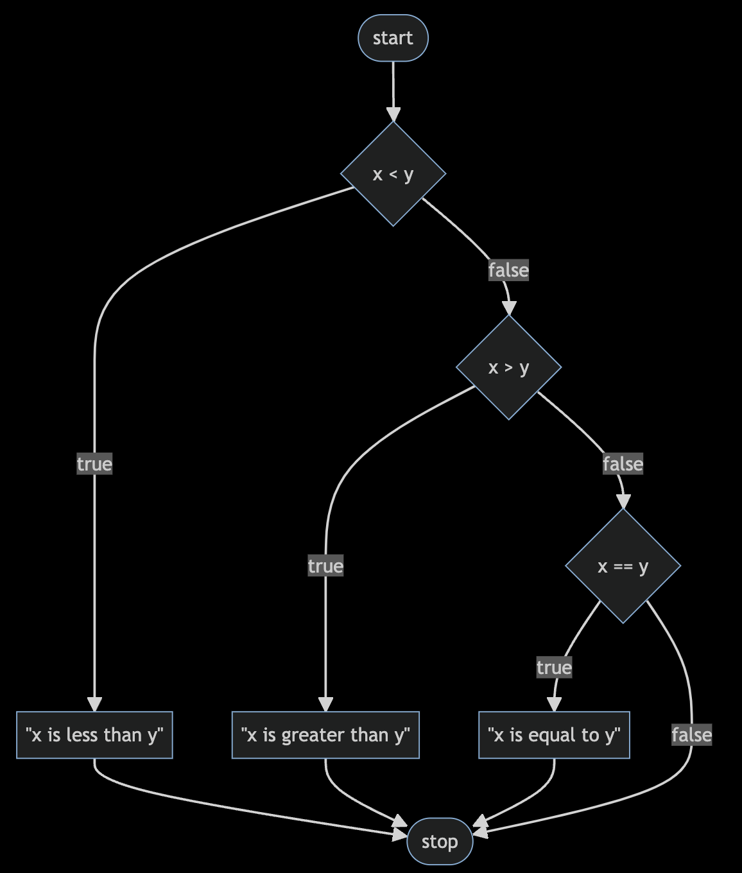
Notes:
compare3.c
https://mermaid.live/edit#pako:eNptkc9ugzAMxl_F8i6rRF-ArZXWhraXnbbTGg4WSQsqEJo_WhHi3RdAMNCWU77P9s-J3WCihMQQL7n6TlLSFj4ZL8Gft-ezsd6IV7Beb2HXPOAV6nYI7rwHVjvZx_Znjk93p-zLAzIDuTQGbEol1IPLMZ6VXSg3Qx3zzO3EZAtmtGRetSQr9f9YtsQePHazmbiHBfe45Mq7oxys-sM89tmnbgiqilcz1G-j0-Du5yIaBQZYSF1QJvx4my7I0aaykBxDfxWkbxx52fo8clZ91GWCYffMAF0l_GdZRldNBYZ9w9GNRGaVnkzZy_dhif0uA6yo_FJqLGx_AMcUkcQ

Slide 112
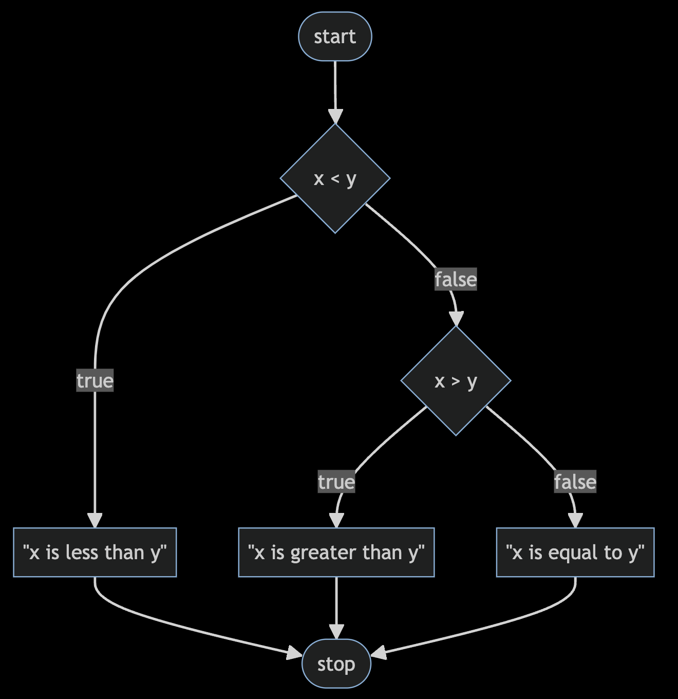
Notes:
compare4.c
https://mermaid.live/edit#pako:eNptkctOwzAQRX9lNGyolP5AQJVonYoNK1hRZzGK3SYisVM_RKMo_45jKxUReOU5M_dqHiNWWkjM8dzq76om4-CDcQXhvTyerAug3MB2u4P9eINnGKaU3AcGzngZc4cTx4er1-7pBo2FVloLriYFQ6Icy1-yM7U26Vjw3N092cqzWHtejCQnzf-2bG17XEvl1VMLTv-RHWP16zyn7stNgocEU1AsAWbYSdNRI8KuxjnJ0dWykxzz8BVkvjhyNYU68k6_D6rCfJ4lQ9-L0Dlr6GKowzy2udBCNE6bO5QxfEsXiYfJsCf1qfUinH4AYdKEwg

Slide 113
bool
char
double
float
int
long
string
...

Slide 114
bool
char
double
float
int
long
string
...

Slide 115
get_char
get_double
get_float
get_int
get_long
get_string
...

Slide 116
get_char
get_double
get_float
get_int
get_long
get_string
...
Notes:
agree{0,1,2}.c

Slide 117
loops
Notes:
cat0.c

Slide 118
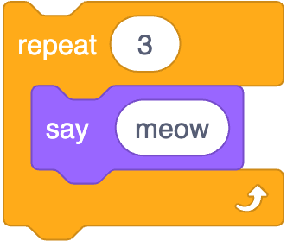
Notes:
https://scratchblocks.github.io/#?style=scratch3&script=repeat%20%5B3%5D%0Asay%5Bmeow%5D

Slide 119
int i = 3;
while (i > 0)
{
printf("meow\n");
i--;
}
Notes:
cat1.c, but use counter first

Slide 120
int i = 3;
while (i > 0)
{
printf("meow\n");
i--;
}
Notes:
cat1.c, but use counter first

Slide 121
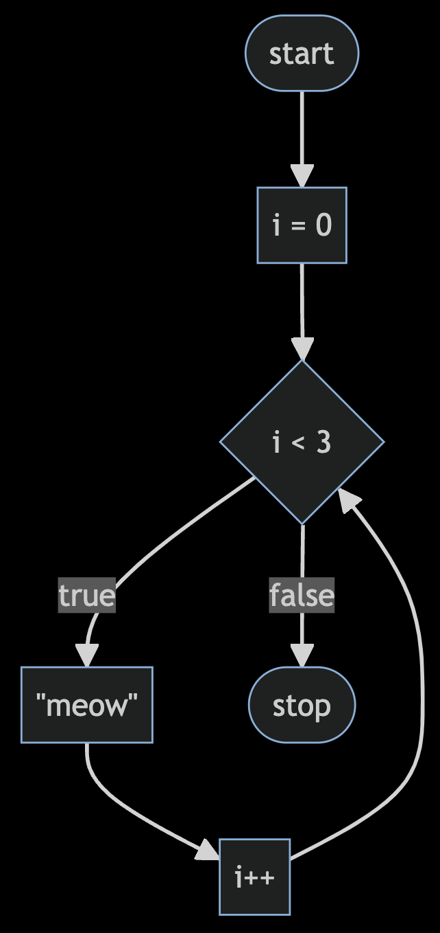
Notes:
https://mermaid.live/edit#pako:eNpNkEFvwjAMhf-KZS4gioS0WzeQgHa3ncaJpgerSUc0EnchFZqq_velCUz4ZH9-fnrygA1LhTm2F741Z3IejoWwEGo3r64-gHoBq9UW9pWGDazrtNxHdhg0vMHLmNghMPCuV3FXVAJnPz37V6P4ljqB9_MiSspKL5d3UibDJ6eWLtdk9T4l4a5eCIsZGuUMaRkyD5NaoD8rowTmoZXkvgUKOwYd9Z4_f22D-ZQpw76T5FWh6cuRwTzaP2gptWf3D1UcP9Jn4oMy7MiemB-H4x_2fV7F

Slide 122
int i = 0;
while (i < 3)
{
printf("meow\n");
i++;
}
Notes:
cat{2,3}.c

Slide 123
for (int i = 0; i < 3; i++)
{
printf("meow\n");
}
Notes:
cat4.c

Slide 124
Notes:
https://mermaid.live/edit#pako:eNpNkEFvwjAMhf-KZS4gioS0WzeQgHa3ncaJpgerSUc0EnchFZqq_velCUz4ZH9-fnrygA1LhTm2F741Z3IejoWwEGo3r64-gHoBq9UW9pWGDazrtNxHdhg0vMHLmNghMPCuV3FXVAJnPz37V6P4ljqB9_MiSspKL5d3UibDJ6eWLtdk9T4l4a5eCIsZGuUMaRkyD5NaoD8rowTmoZXkvgUKOwYd9Z4_f22D-ZQpw76T5FWh6cuRwTzaP2gptWf3D1UcP9Jn4oMy7MiemB-H4x_2fV7F

Slide 125
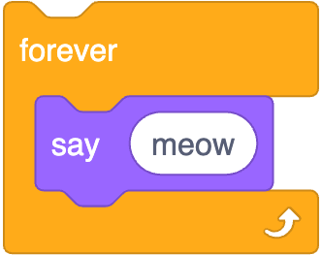
while (true)
{
printf("meow\n");
}
Notes:
https://scratchblocks.github.io/#?style=scratch3&script=forever%0Asay%5Bmeow%5D

Slide 126
while ( )
{
}

Slide 127
while (true)
{
}

Slide 128
while (true)
{
printf("meow\n");
}
Notes:
cat5.c

Slide 129
control-c

Slide 130
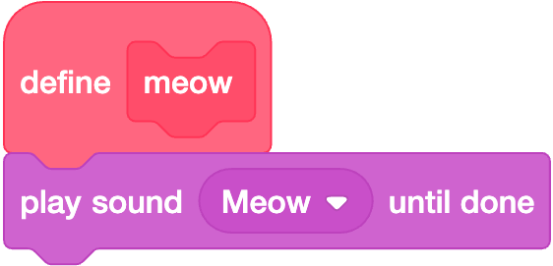

Slide 131
void meow(void)
{
printf("meow\n");
}

Slide 132
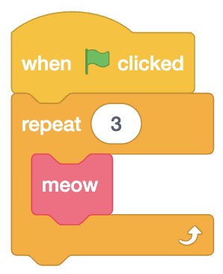

Slide 133
int main(void)
{
for (int i = 0; i < 3; i++)
{
meow();
}
}
Notes:
cat6.c

Slide 134
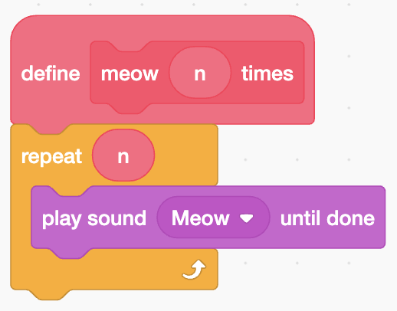

Slide 135
void meow(int n)
{
for (int i = 0; i < n; i++)
{
printf("meow\n");
}
}

Slide 136
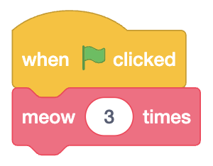

Slide 137
int main(void)
{
meow(3);
}
Notes:
cat{7,8}.c

Slide 138
scope
Notes:
cat9.c

Slide 139

If you'd like a stress ball, what do today's binary bulbs spell?
Notes:
https://emojipedia.org/cookie/

Slide 140
int main(void)
{
meow(3);
}
Notes:
cat{7,8}.c

Slide 141
Linux

Slide 142
correctness, design, style

Slide 143
check50, design50, style50

Slide 144
function
arguments →
→ side effects

Slide 146
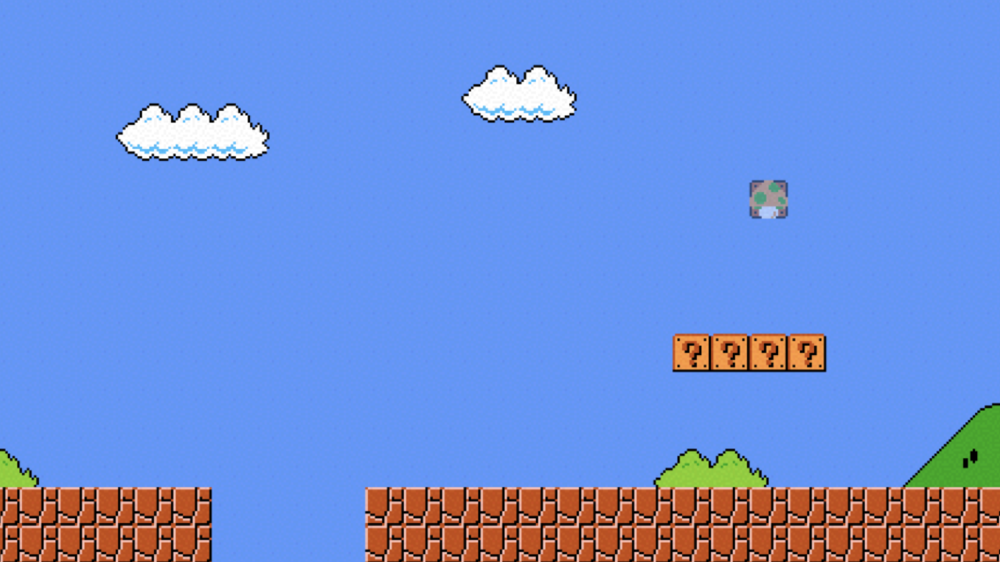

Slide 147
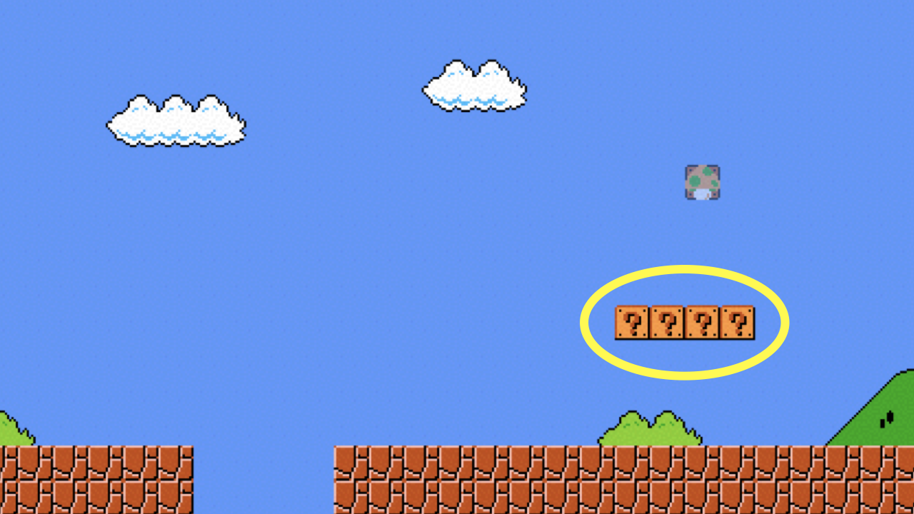
Notes:
mario{0,1}.c

Slide 148
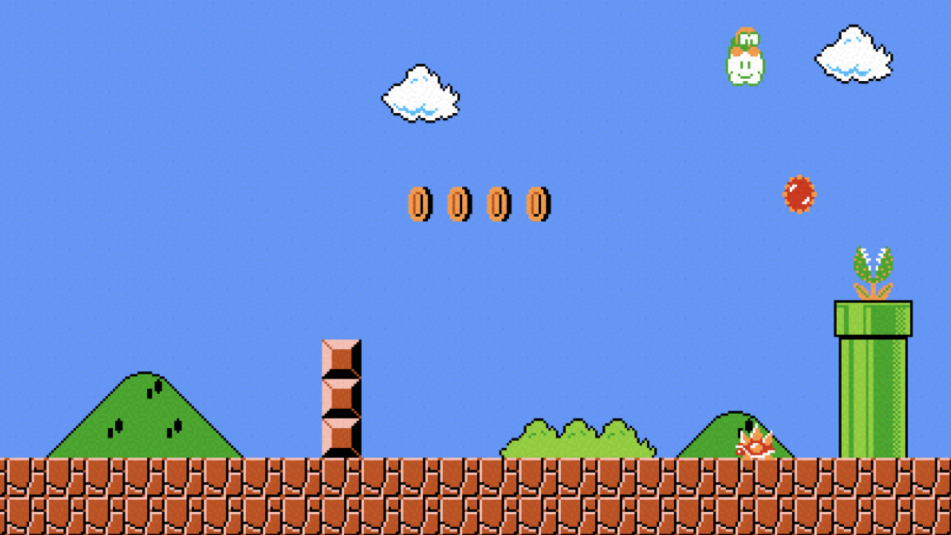

Slide 149
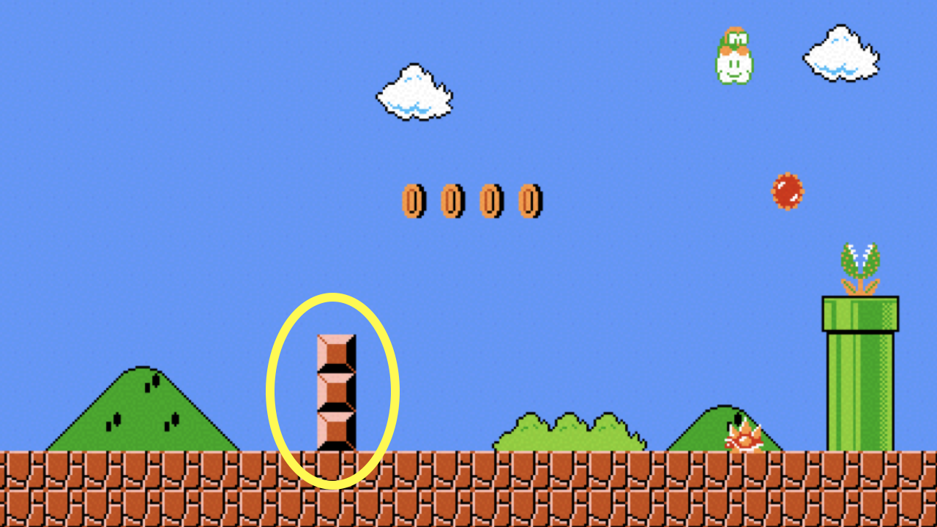
Notes:
mario2.c

Slide 150
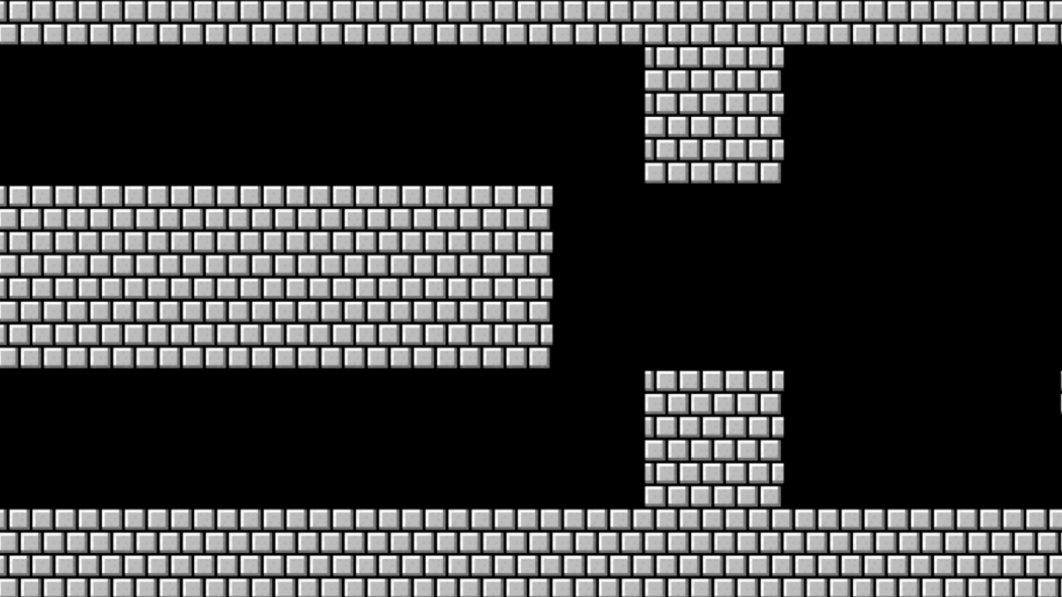

Slide 151
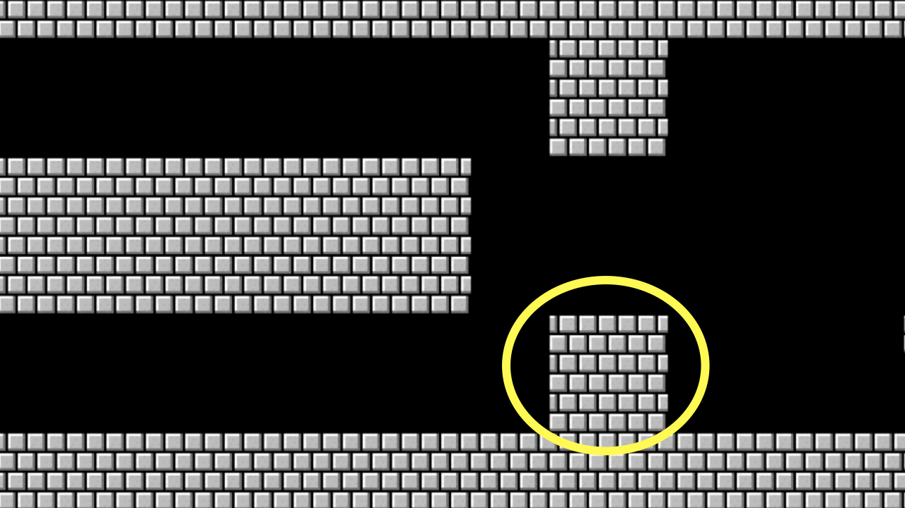
Notes:
mario{3,4,5}.c

Slide 152
constants

Slide 153
comments

Slide 154
function
arguments →
→ return value

Slide 155
+
-
*
/
%
…
Notes:
calculator*.c

Slide 156
integer overflow

Slide 157
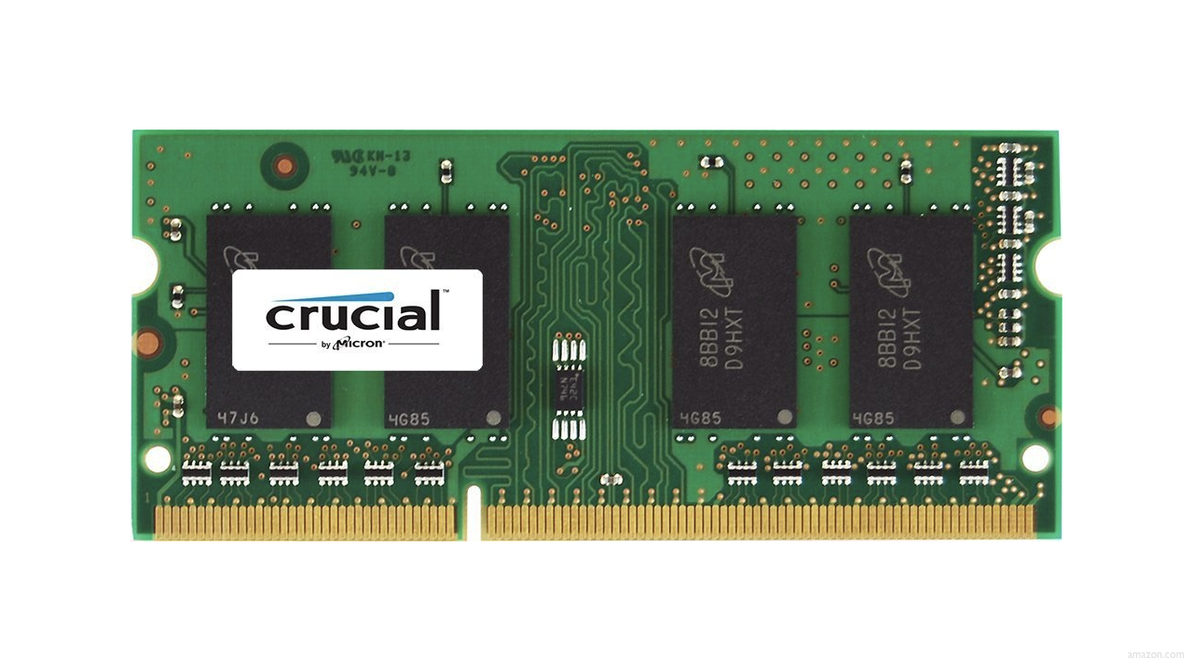

Slide 158
0000

Slide 159
0001

Slide 160
0010

Slide 161
0011

Slide 162
0100

Slide 163
0101

Slide 164
0110

Slide 165
0111

Slide 166
1000

Slide 167
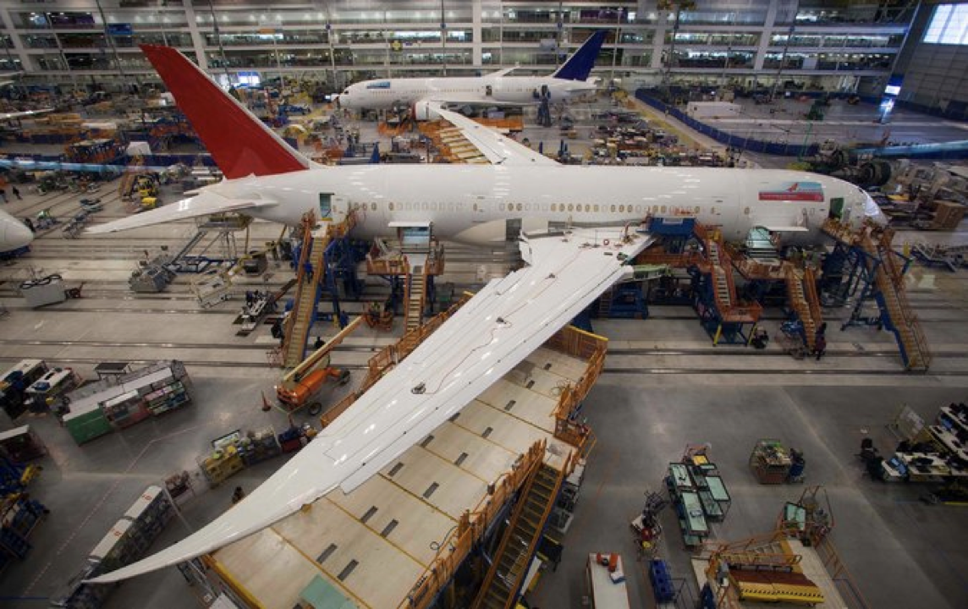
Notes:
Boeing 787
"a Model 787 airplane that has been powered continuously for 248 days can lose all alternating current (AC) electrical power due to the generator control units (GCUs) simultaneously going into failsafe mode," the memo stated. "This condition is caused by a software counter internal to the GCUs that will overflow after 248 days of continuous power... Boeing is in the process of developing a GCU software upgrade that will remedy the unsafe condition." - http://arstechnica.com/information-technology/2015/05/boeing-787-dreamliners-contain-a-potentially-catastrophic-software-bug/
A simple guess suggests the the problem is a signed 32-bit overflow as 2^31 is the number of seconds in 248 days multiplied by 100, i.e. a counter in hundredths of of a second.
https://www.i-programmer.info/news/149-security/8548-reboot-your-dreamliner-every-248-days-to-avoid-integer-overflow.html

Slide 168
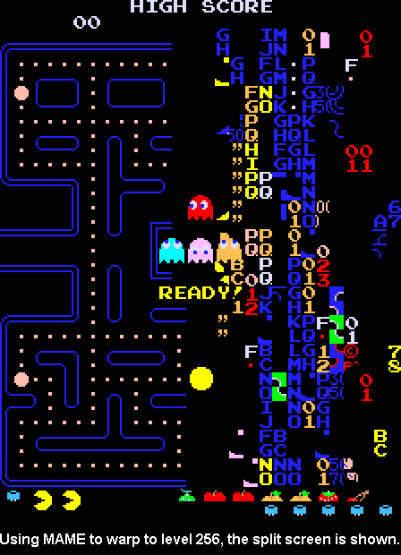
Notes:
https://pacman.fandom.com/wiki/Map_256_Glitch
"The level counter in the original Pac-Man is stored as an 8-bit integer, meaning the highest value it can hold is 255. The level counter starts with 0 internally, but for calculating the fruit counter it adds 1; however, because of overflow, adding 1 to 255 would result in 0, and the game tries to count fruits from 1, causing the game to attempt to draw 256 fruit to the screen until it overflows to 0. The result is the garbled mess on the right side of the maze, because the screen memory starts with the bottom, followed by the columns from the right side."

Slide 169
truncation

Slide 170
floating-point imprecision
Notes:
1/3

Slide 171
1999
Notes:
graduated

Slide 172
1999

Slide 173
1900

Slide 174
19 January 2038

Slide 175
13 December 1901

Slide 176
